Slide 1

Lab 8: Dask

Slide 2

Dask
Dask is a flexible parallel computing library designed for out-of-core computations.
It facilitates large-scale computations using many smaller, interdependent tasks spread across multiple cores or machines.
Comparison to Spark:
Language: Dask is fully implemented in Python, whereas Spark is written in Scala and uses JVM
Memory Mangement: Dask uses the Python memory management, whereas Spark uses its own memory manager.
Scalability: Spark is considered better for data-intensive tasks on very large datasets (multi-petabyte range), because of its mature cluster management capabilities and optimizations. Dask is useful for data that doesn't necessarily warrant the overhead of managing a Spark cluster
Notes:
We can think of Dask at a high and a low level
High level collections: Dask provides high-level Array, Bag, and DataFrame collections that mimic NumPy, lists, and Pandas but can operate in parallel on datasets that don't fit into memory. Dask's high-level collections are alternatives to NumPy and Pandas for large datasets.
Low Level schedulers: Dask provides dynamic task schedulers that execute task graphs in parallel. These execution engines power the high-level collections mentioned above but can also power custom, user-defined workloads. These schedulers are low-latency (around 1ms) and work hard to run computations in a small memory footprint. Dask's schedulers are an alternative to direct use of threading or multiprocessing libraries in complex cases or other task scheduling systems like Luigi or IPython parallel.

Slide 3
Dask
Dask is composed of two parts:
Dynamic task scheduling. Dask optimizes complex, dynamic workloads using a task scheduling system that resembles a more sophisticated version of the Python multiprocessing library.
“Big Data” collections like parallel arrays, dataframes, and lists that extend common interfaces like NumPy, Pandas, or Python iterators to larger-than-memory or distributed environments. These parallel collections run on top of dynamic task schedulers.
Notes:
We can think of Dask at a high and a low level
High level collections: Dask provides high-level Array, Bag, and DataFrame collections that mimic NumPy, lists, and Pandas but can operate in parallel on datasets that don't fit into memory. Dask's high-level collections are alternatives to NumPy and Pandas for large datasets.
Low Level schedulers: Dask provides dynamic task schedulers that execute task graphs in parallel. These execution engines power the high-level collections mentioned above but can also power custom, user-defined workloads. These schedulers are low-latency (around 1ms) and work hard to run computations in a small memory footprint. Dask's schedulers are an alternative to direct use of threading or multiprocessing libraries in complex cases or other task scheduling systems like Luigi or IPython parallel.

Slide 4
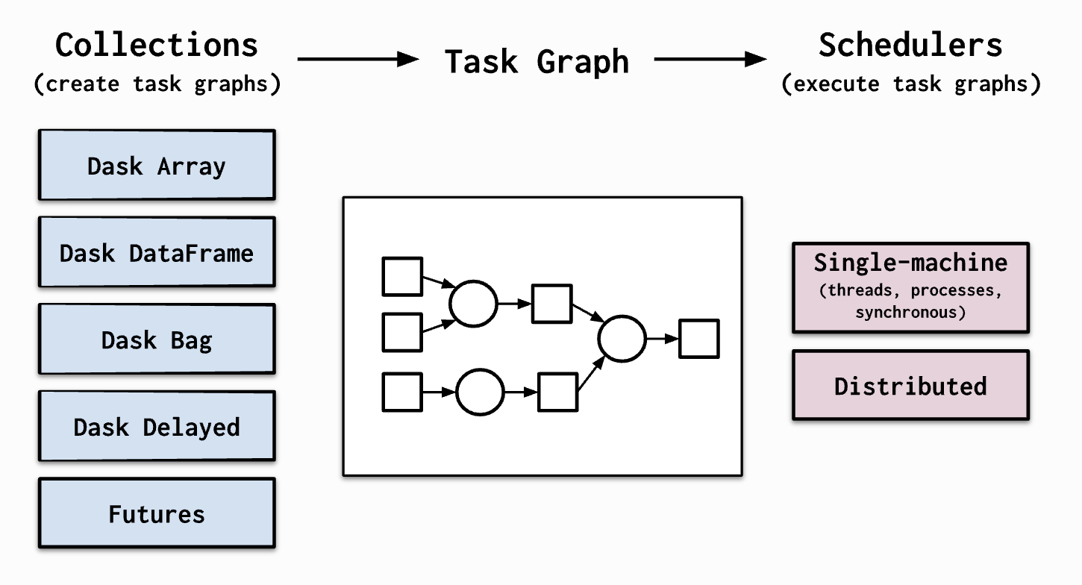
Why dask?
Operates with low overhead, low latency, and minimal serialization necessary for fast numerical algorithms.
Scales up, scales down easily.
Responsive: interactive computing.
Read about the components from the Dask documentation to ease up your assignment.

Slide 5
Dask & Jupyter Lab on Greene
If not on NYU network, connect to NYU-VPN
Install & setup NYU VPN (Mac Instructions, Windows Instructions)
Go to https://ood.hpc.nyu.edu/ (Web Interface for Greene Cluster)
Click on Clusters -> Greene Shell Access
Clone your repository “git clone <YOUR PROJECT REPOSITORY URL>”
Launch Jupyter Dask Session
Click on “Interactive Apps” -> “DS-GA.1004 – Jupyter Dask”
Wait for resources to be allocated and click “Connect to Jupyter”

Slide 6
The Dask assignment
Global Historical Climatology Network - Daily (GHCN-Daily) Link
The dataset integrates daily climate observations from approximately 30 different data sources.
It contains station-based measurements from well over 90,000 land-based stations worldwide.
Records metrics like daily maximum and minimum temperature, temperature at the time of observation, snowfall and snow depth.

Slide 7
Homework 5 Assignment: Connect to VPN!
On Brightspace Assignment --- Homework 5
Instructions for the assignment are provided in the README file of the repository.

Slide 8
Homework 5 Assignment
Start by connecting to VPN if not on NYU Network
Log into Greene and clone repo.
Launch DSGA 1004 Jupyter Dask Interactive Lab.
Go over the starter notebook and then in the GHCN analysis notebook, load the parsed data into bags and then compute on it .
Also remember to answer the questions asked in REPORT.md and push these codes and report to git repo.

Slide 9
Homework 5 Assignment - Tips
Filter the data as early as possible in the computation
- if attributes won’t be used, get rid of them early!
Try to control the number of partitions early on.
The dataset format is explained in Section III.
The Dask dashboard link generated after creating a client may not work. That is due to requirement of a secure tunnel. So do not worry if it doesn’t connect.
Start the assignment way before you think you should. Waiting for resources a day before the assignment submission would be a buzz killer.

Slide 10
Questions?

